Slide 1
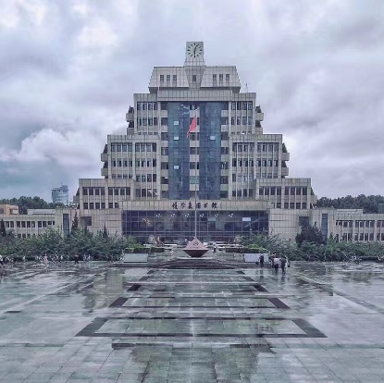
Summer School Project
Microeconomics
Lihua Xu
Xi’an Jiaotong University
China
2
0
2
2

Slide 2
Principles of Economics
Gains from Trade
Supply and Demand
Elasticity and
Its Applications
Production
Contents
Economist and
The Economics Models

Slide 3
senior high school
students
college students
anyone who is
interested
in economics
for WHOM ?

Slide 4
Brief information of the lecturer
Lihua Xu, PhD in economics,a master student supervisor,is an solution-oriented and experienced instructor in the School of Economics and Finance of Xi'an Jiaotong University,China.
Her main research fields fall in the international trade theory and policy, microeconomics and business. She teaches international trade, business English, and microeconomics in English.
She has participated in and presided over the national and provincial projects. She also participated in and presided over a number of provincial and university-level educational reform projects. She has published more than 10 academic papers.

Slide 5
Main Awards for Teaching
2015, “Certificate of Excellence in Teaching ”by Lincoln Public Schools, Nebraska,USA
2015, ”Honorary Citizen” by Mayor of Lincoln ,Nebraska,USA
2019, “Teaching Contribution Award” by School of Economics and Finance of Xi’an Jiaotong University
2019, “Outstanding Teaching Award" by Xi'an Jiaotong University for English course "Microeconomics Theories and Applications"
2021, “Outstanding Teaching Award" by Xi'an Jiaotong University for English course "Microeconomics Theories and Applications"
2021, ranked the third best teacher on the list of student’s evaluation of their teachers in School of Economics & Finance，Xi'an Jiaotong University

Slide 6
Class sessions:
16x50mins in total,
2x50mins each day
Beijing time 19:00-21:00
July 18th -July 25th,2022, daily
online Tencent Meeting
https://meeting.tencent.com/dm/0vCvvODNu1AT
Tencent Meeting Code：476-7339-7480

Slide 7
Free
Join Us ！
Register Here：https://www.wjx.cn/vm/YtpOg5G.aspx
Xi’an Jiaotong University
China
2
0
2
2

