Slide 1
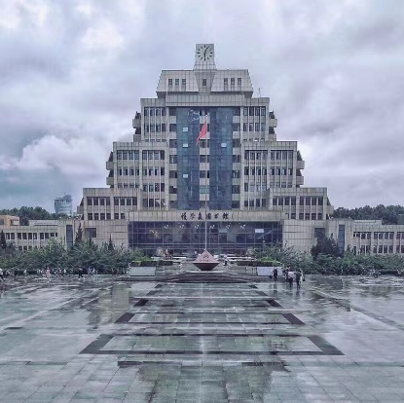
Summer School Project
Economics
Lihua Xu
Guiyuan Ma
Tianyuan Luo
Xi’an Jiaotong University
China
2
0
2
3

Slide 2
What decides the
market price?
Who gains no satisfaction
after shopping?
Content
Why raise price doesnt always
mean more revenue
How does government’s intervention affect the market equilibrium?
Is price discrimination legal or ethical?

Slide 3
Game theory in your daily life
Is it better as economy
scale gets larger and larger?
VIsible Hand
Content
Life of money.
Graduation examination

Slide 4
Undergraduate
Postgraduate
Anyone who is
interested
in economics
for WHOM ?

Slide 5
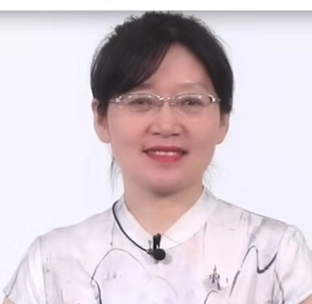
Brief information of the lecturers
Dr.Lihua Xu, PhD in economics,a master student supervisor,is an solution-oriented and experienced instructor in the School of Economics and Finance of Xi'an Jiaotong University,China.
She teaches international trade, business English, and microeconomics in English.
She has participated in and presided over the national and provincial projects and has published academic papers in the field of international trade , service trade etc.

Slide 6
Main Awards for Teaching
2015, “Certificate of Excellence in Teaching ”by Lincoln Public Schools, Nebraska,USA
2015, ”Honorary Citizen” by Mayor of Lincoln , Nebraska, USA
2019, “Teaching Contribution Award” by School of Economics and Finance of Xi’an Jiaotong University
2019, “Outstanding Teaching Award" by Xi'an Jiaotong University for English course "Microeconomics Theories and Applications"
2021, “Outstanding Teaching Award" by Xi'an Jiaotong University for English course "Microeconomics Theories and Applications"
2021, ranked the third best teacher on the list of student’s evaluation of their teachers in School of Economics & Finance, Xi'an Jiaotong University

Slide 7
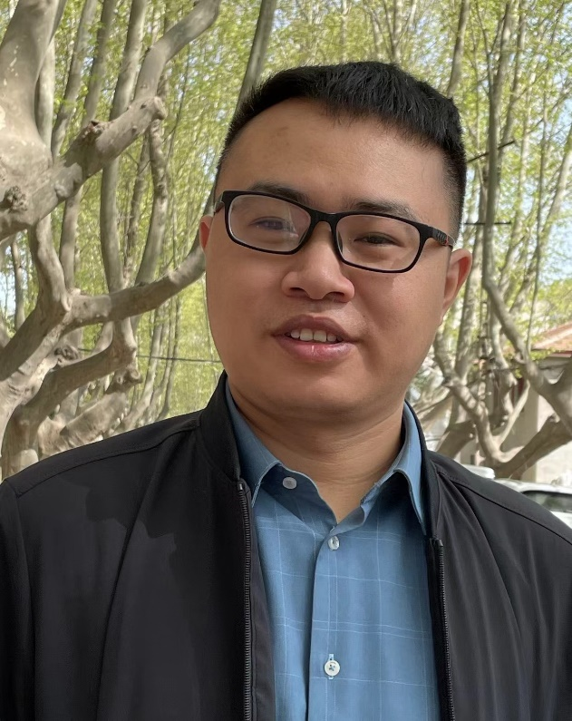
Brief information of the lecturers
Dr.Guiyuan Ma, Assistant Professor
in School of Economics and Finance, XJTU .
He is Member of Committee for the 2nd International Mathematical Finance and reviewer for the international journals such as: European Journal of Operational Research, Insurance Mathematics and Economics, International Review of Economics and Finance, Economic Modelling etc. He has published papers in the SSCI/SCI journals such as in Insurance: Mathematics and Economics, European Journal of Operational Research, Quantitative Finance etc.

Slide 8
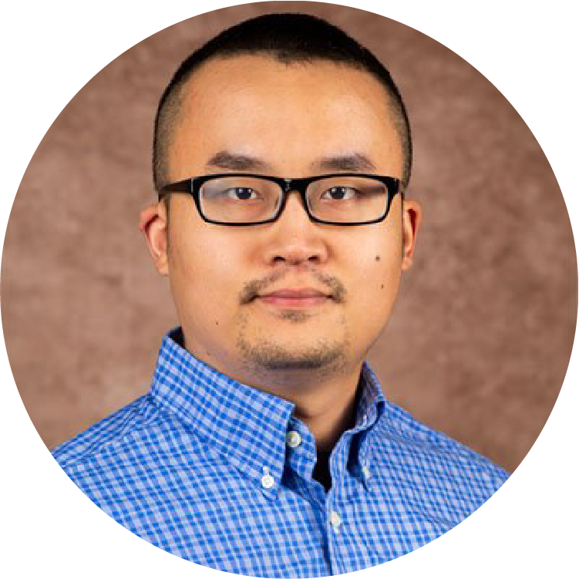
Brief information of the lecturers
Dr. Tianyuan Luo, is an associate professor in School of Economics and Finance, XJTU. He received his Ph.D from the University of Georgia in the U.S. His research interests are labor supply and demand, rural development, and health economics. So far, Dr. Luo has published peer-reviewed papers in the SSCI/SCI journals such as American Journal of Agricultural Economics, Health Economics , European Review of Agricultural Economics, and Journal of Regulatory Economics.

Slide 9
Class sessions:
18x50mins in total,
2x50mins each day
Time: sent after register
July 10th -July 19th ,2023, daily
Teaching in classroom with
online Tencent Meeting
(link sent after register)

Slide 10
Welcome to click the link and register online by
June 5th ,2023.
https://www.wjx.cn/vm/eIIgv5T.aspx#
Wait for you
in XJTU ,China !

Slide 11
free
Join Us ！
Xi’an Jiaotong University
China
2
0
2
3

